Slide 1


Slide 2
Cross-Platform Native User Interfaces with Xamarin.Forms
Naweed Akram
@xgeno / naweed@xgeno.com
Developer/Evangelist @ XGENO Software

Slide 3
Meet Xamarin.Forms
Build native UIs for iOS, Android, and Windows
from a single, shared C# codebase.

Slide 4

Xamarin + Xamarin.Forms
iOS C# UI
Android C# UI
Windows C# UI
Shared UI Code
Shared C# Backend
Shared C# Backend
Traditional Xamarin Approach
With Xamarin.Forms: More code-sharing, all native

Slide 5
What’s included
✓ 40+ Pages, layouts, and controls
(Build from code behind or XAML)
✓ Two-way data binding
✓ Navigation
✓ Animation API
✓ Dependency Service
✓ Messaging Center
Shared UI Code
Shared C# Backend

Slide 6

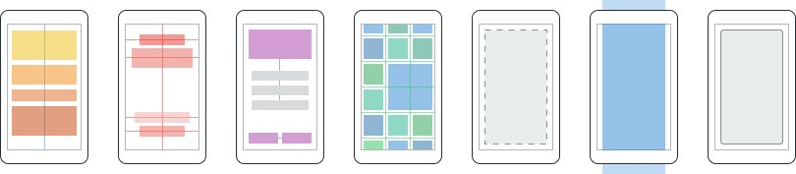
Layouts
Pages
Content
MasterDetail
Navigation
Tabbed
Carousel
Stack
Absolute
Relative
Grid
ContentView
ScrollView
Frame
Notes:
Inside of a page are layouts
A lot of options from something simple like a stack panel to complex and powerful grids

Slide 7
Controls
ActivityIndicator
BoxView
Button
DatePicker
Editor
Entry
Image
Label
ListView
Map
OpenGLView
Picker
ProgressBar
SearchBar
Slider
Stepper
TableView
TimePicker
WebView
EntryCell
ImageCell
SwitchCell
TextCell
ViewCell
Notes:
You have more than 40 controls, layouts, and pages to mix and match from.
These are all of the controls you have out of the box, you can of course create your own.
What is unique is you get the native control and have access to it.
Consider an Entry Field
On iOS it is mapped to UITextField
Android it is EditText
Windows Phoen it is a TextBox

Slide 8


Xamarin.Forms Ecosystem

Slide 9
Control Comparison
Windows | Xamarin.Forms
StackPanel | StackLayout
TextBox | Entry
ListBox | ListView
CheckBox | Switch
ProgressBar | ActivityIndicator
Grid | Grid
Label | Label
Button | Button
Image | Image
Date/TimePicker | Date/TimePicker

Slide 10
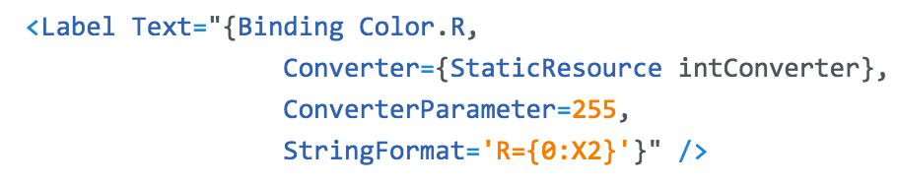
Windows | Xamarin.Forms
DataContext | BindingContext
{Binding Property} | {Binding Property}
ItemsSource | ItemsSource
ItemTemplate | ItemTemplate
DataTemplate | DataTemplate
Binding
Comparison

Slide 11
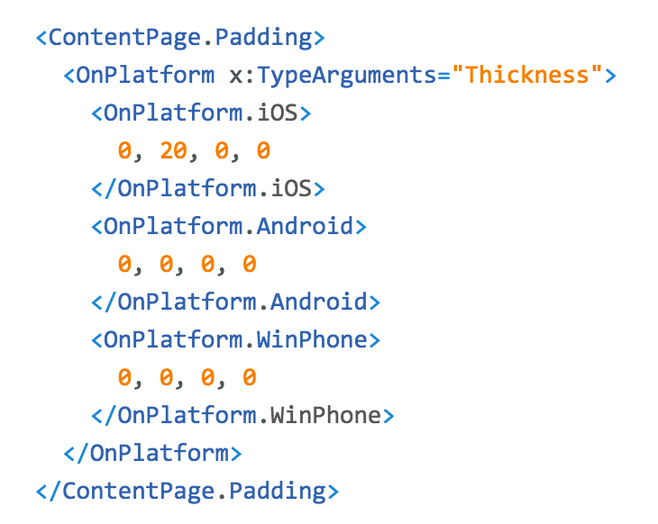
Platform
Customization

Slide 12
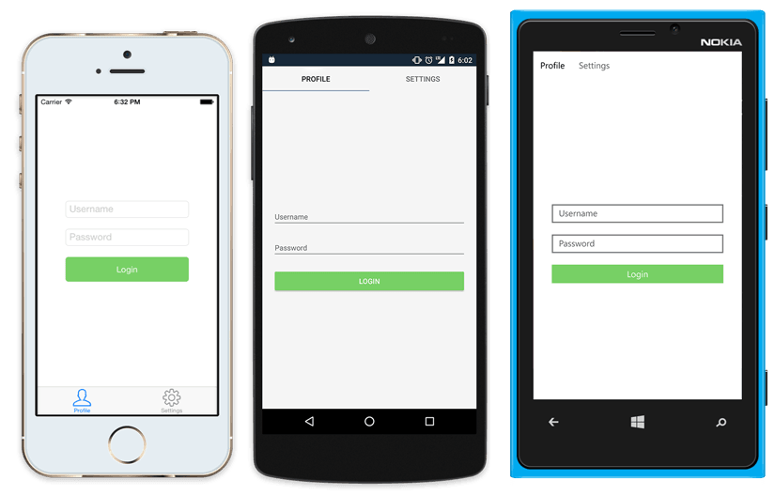
Native UI from shared code
<?xml version="1.0" encoding="UTF-8"?>
<TabbedPage xmlns="http://xamarin.com/schemas/2014/forms"
xmlns:x="http://schemas.microsoft.com/winfx/2009/xaml"
x:Class="MyApp.MainPage">
<TabbedPage.Children>
<ContentPage Title="Profile" Icon="Profile.png">
<StackLayout Spacing="20" Padding="20"
VerticalOptions="Center">
<Entry Placeholder="Username"
Text="{Binding Username}"/>
<Entry Placeholder="Password"
Text="{Binding Password}"
IsPassword="true"/>
<Button Text="Login" TextColor="White"
BackgroundColor="#77D065"
Command="{Binding LoginCommand}"/>
</StackLayout>
</ContentPage>
<ContentPage Title="Settings" Icon="Settings.png">
<!-- Settings -->
</ContentPage>
</TabbedPage.Children>
</TabbedPage>

Slide 13
DEMO

Slide 14
Xamarin.Forms is Open Source!
open.xamarin.com
Notes:
Apple has a developer preview where Xamarin has alphas ready. Google does not offer this.
Android versions are usually 4 to 8 weeks out for a stable release, but alphas and betas are usually earlier.
Xamarin realizes how important having iOS ready because within 24 hours a large portion of iOS users upgrade
Android on the other hand is much different. After 4 months on the market Android 4.4 only had 1% adoption

Slide 15
XAML Previewer

Slide 16
Fast Renderers
Grid
StackLayout
ContentView
Button
Grid
Label
Label
WebView
Button
Image
ScrollView
Image
FORMS STRUCTURE

Slide 17
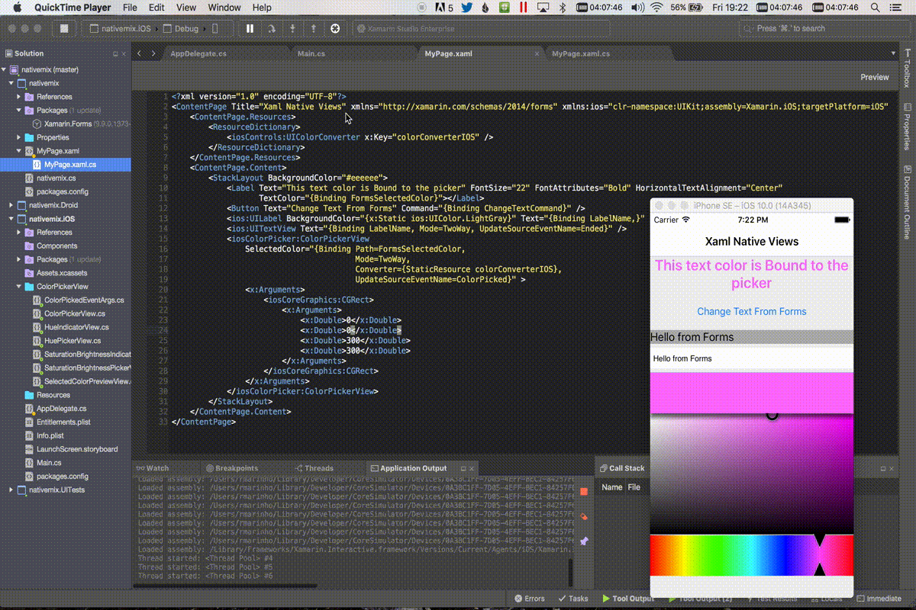
Native View Declarations

Slide 18
More Performance Enhancements
Android Startup
Reduce Android GPU Overdraw
Single DLL

Slide 19
Q & A

